Slide 1
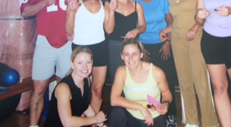

From the Beginning

Slide 2
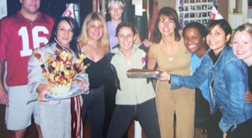
In the Beginning

Slide 3
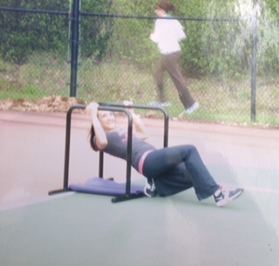
Fitness Wellness Retreat

Slide 4
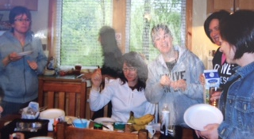
Fitness Retreat

Slide 5
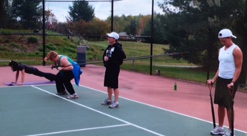
Outdoor Boot Camp

Slide 6
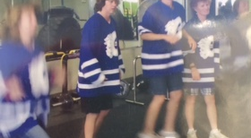
Community Amazing Race

Slide 7
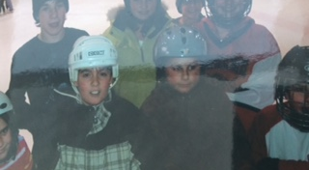
Family Skate Member
Appreciation day

Slide 8
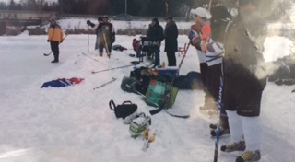
Pond Hockey Tournament

Slide 9
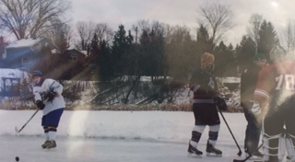
Hockey Training

Slide 10
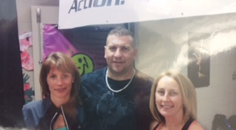
Action in Motion Fundraiser

Slide 11
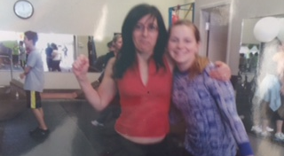
Zumba Day

Slide 12
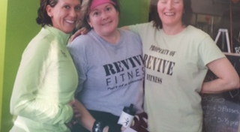
Revive Fitness 10 year Celebration

Slide 13
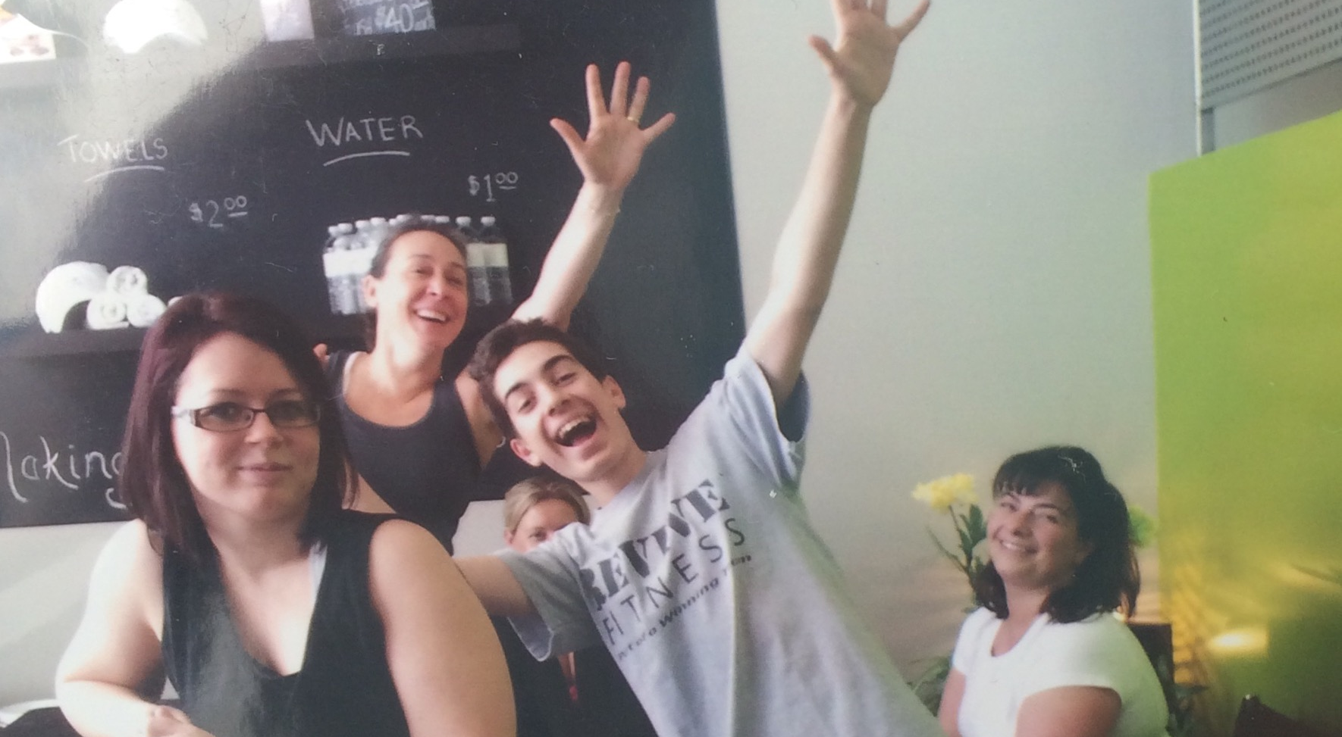
Bolton Grand Opening

Slide 14
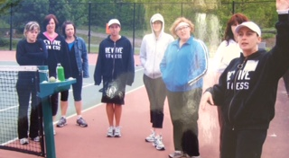
Outdoor Nature Hike

Slide 15
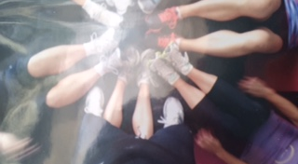
Fitness Body Art

Slide 16
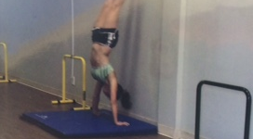
Hand Stand Push Up Challenge

Slide 17
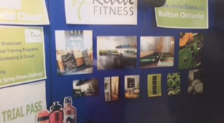
Women’s Day Wellness Booth

Slide 18
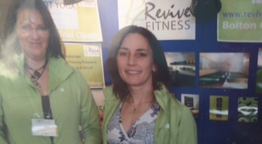
Wellness Demo

Slide 19
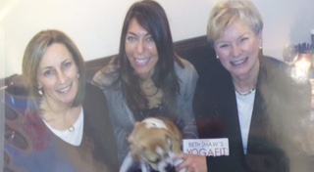
Can Fit Pro Beth Shaw Yoga Fit

Slide 20
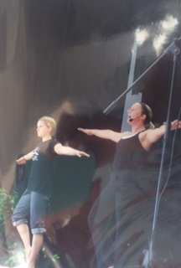
Yoga Day St. Michael High School

Slide 21
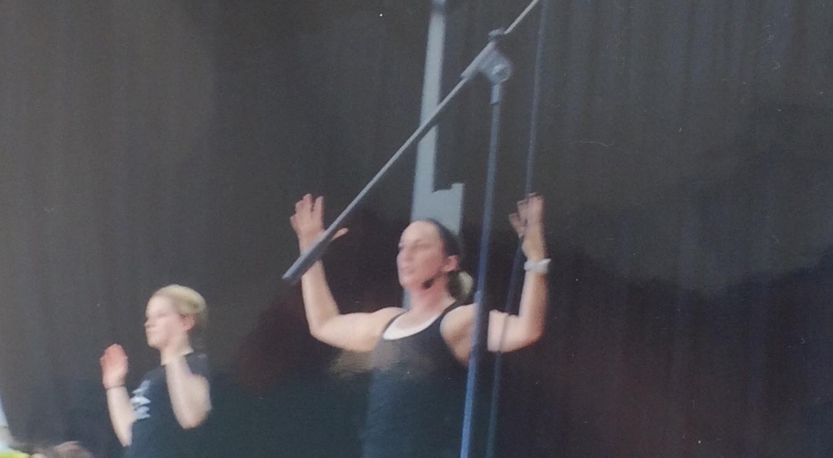
Girls Yoga Day

Slide 22
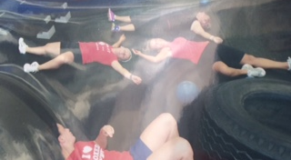
Lunch Time Fitness

Slide 23
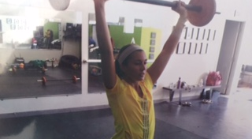
Power Up Strength Class

Slide 24
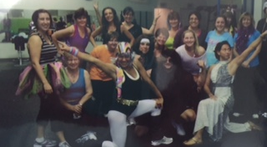
Halloween Specialty Class

Slide 25
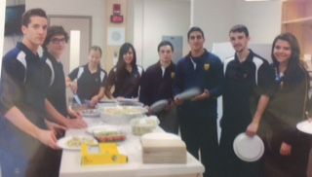
St. Michael High School Nutrition Class

Slide 26
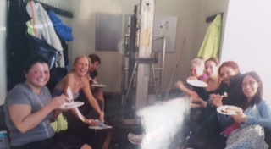
Birthday Celebrations

Slide 27
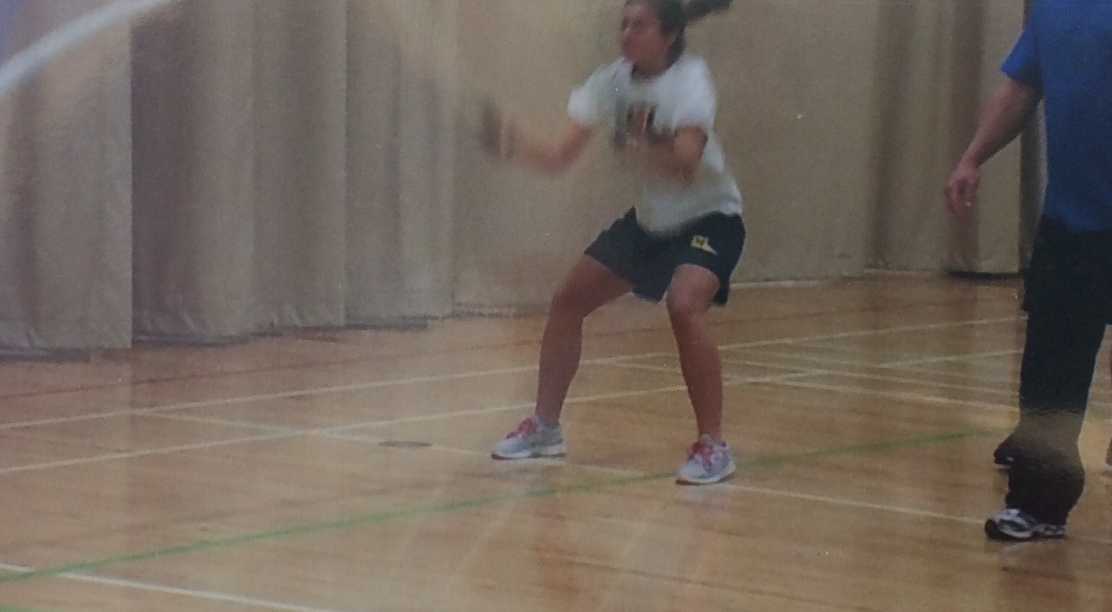
Battle Rope Training

Slide 28
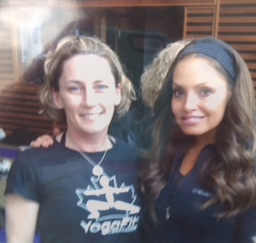
Yoga Fit Fundraiser Toronto

Slide 29
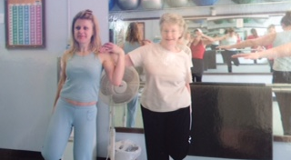
Mother Daughter Fitness

Slide 30
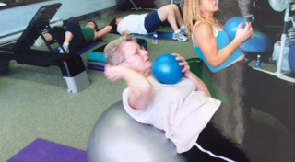
Fitness for All Ages

Slide 31
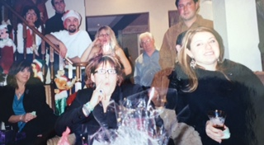
Christmas Celebration

Slide 32
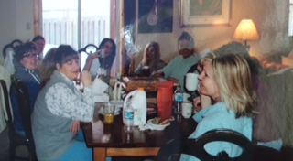
Fitness & Lifestyle Workshop

Slide 33
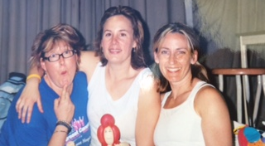
Kids Fit Fundraiser James Bolton

Slide 34
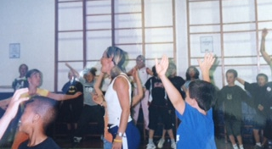
Kids Fit Boot Camp

Slide 35
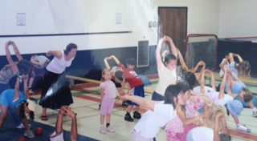
Fitness for Kids

Slide 36
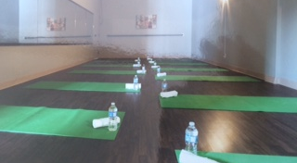
Hot Yoga

Slide 37
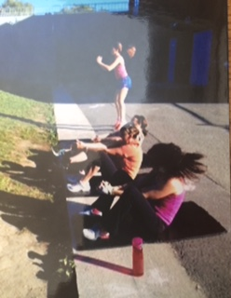
Outdoor Boot Camp
Elwood Public School

Slide 38
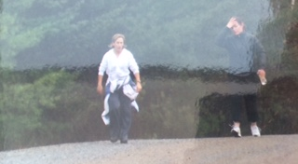
Power Walking Class

Slide 39
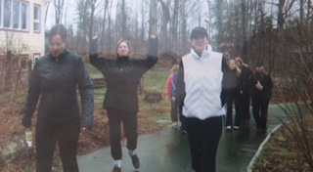
Hiking the Outdoors

Slide 40
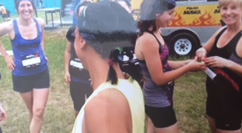
Tough Mudder

Slide 41
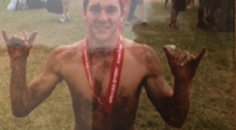
Tough Mudder

Slide 42
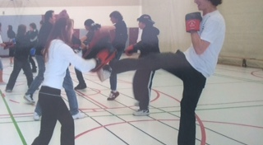
Mayfield High School Kickboxing Empowerment Class

Slide 43
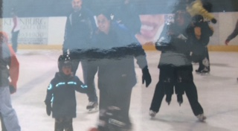
Family Skate

Slide 44
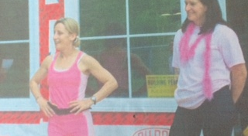
Breast Cancer Fundraiser

Slide 45
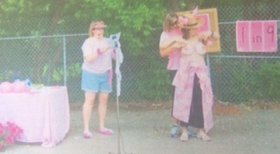
Raising Awareness

Slide 46
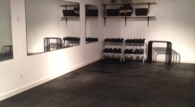
Caledon East Studio

Slide 47
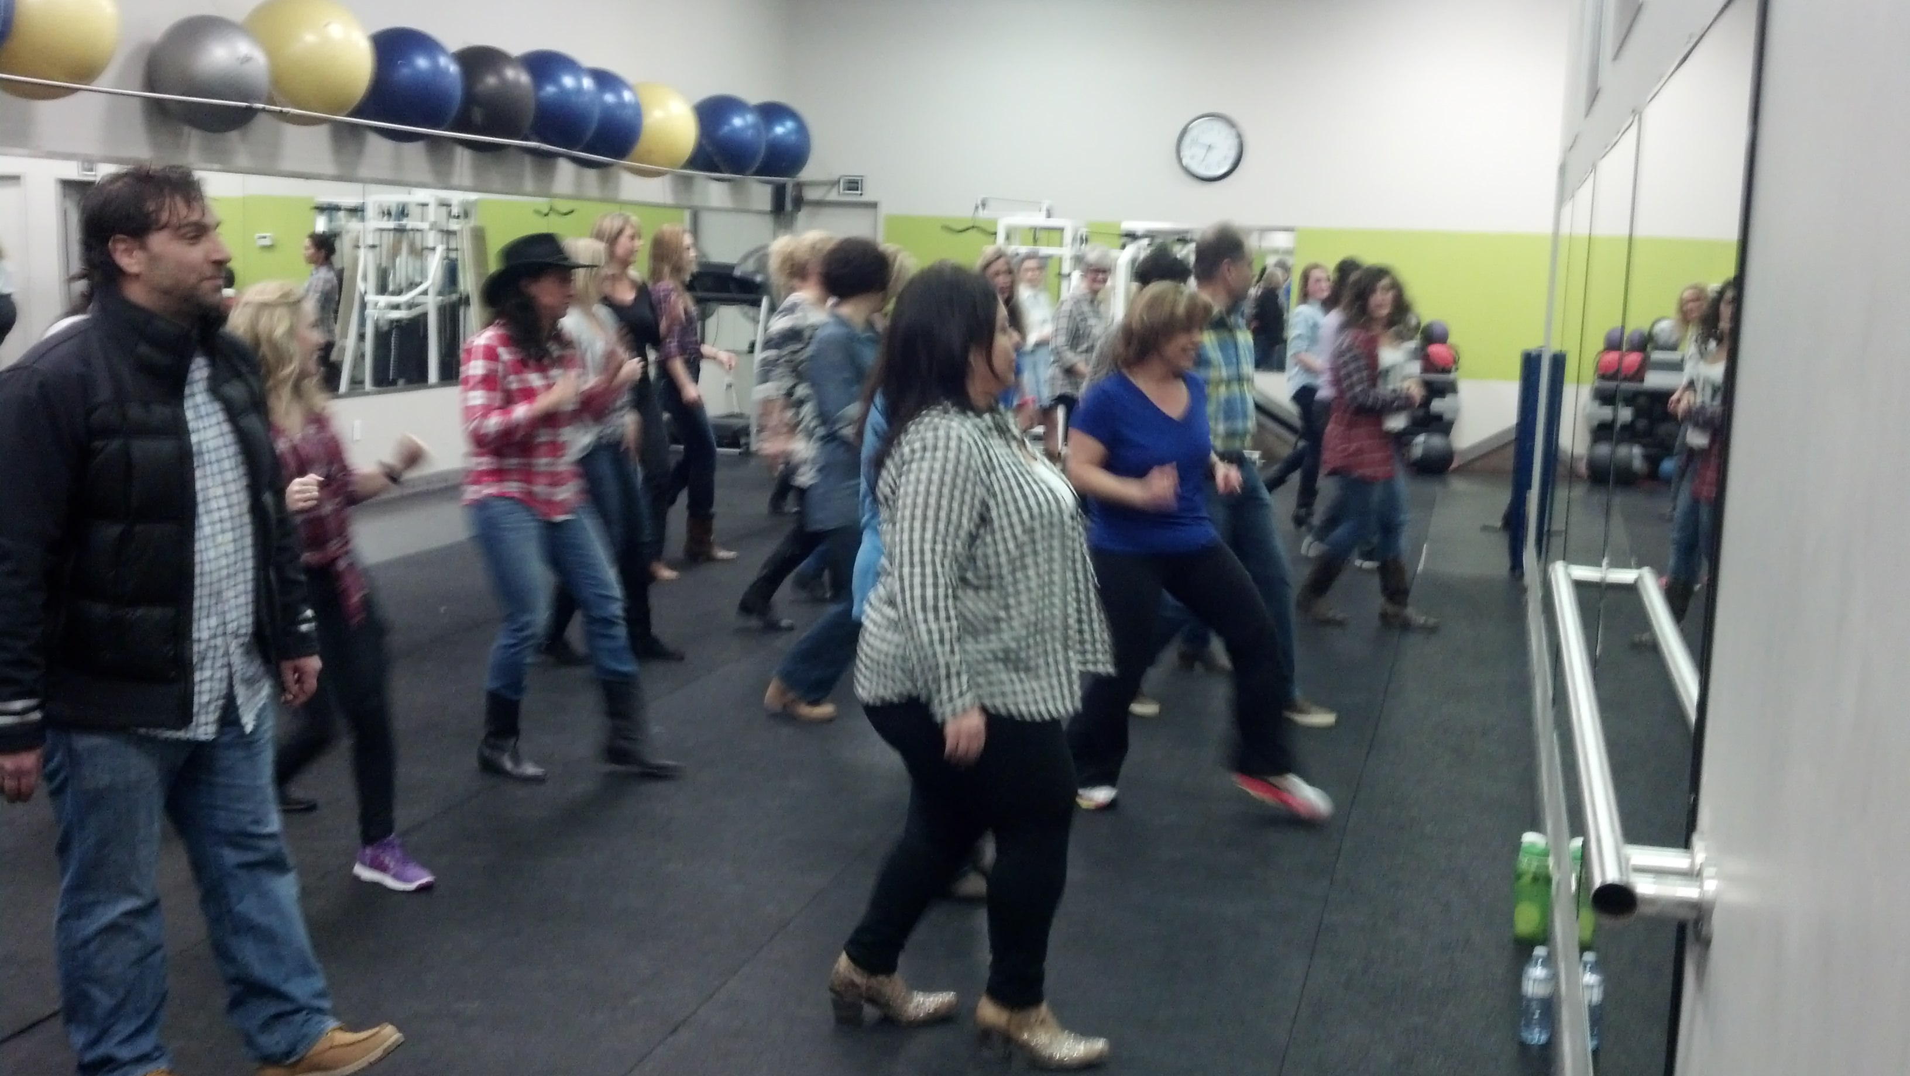
Line Dancing

Slide 48
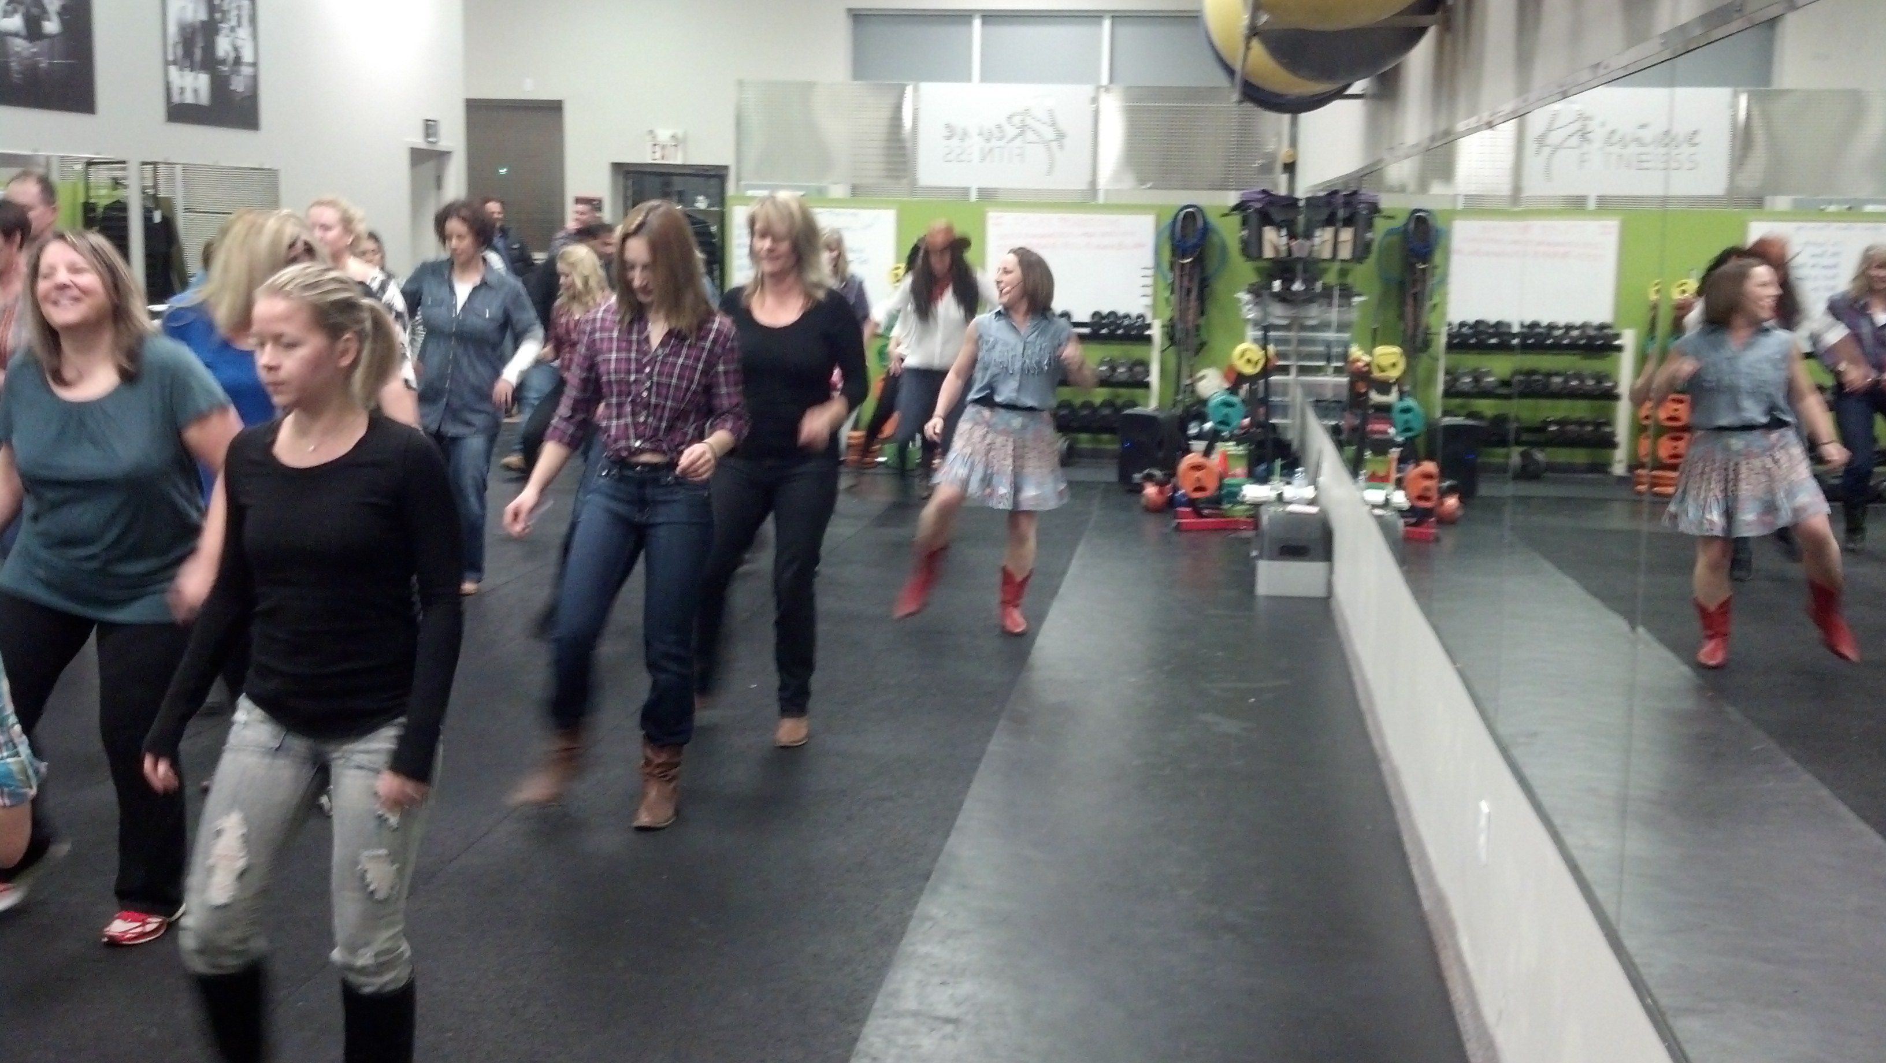
Line Dancing

Slide 49
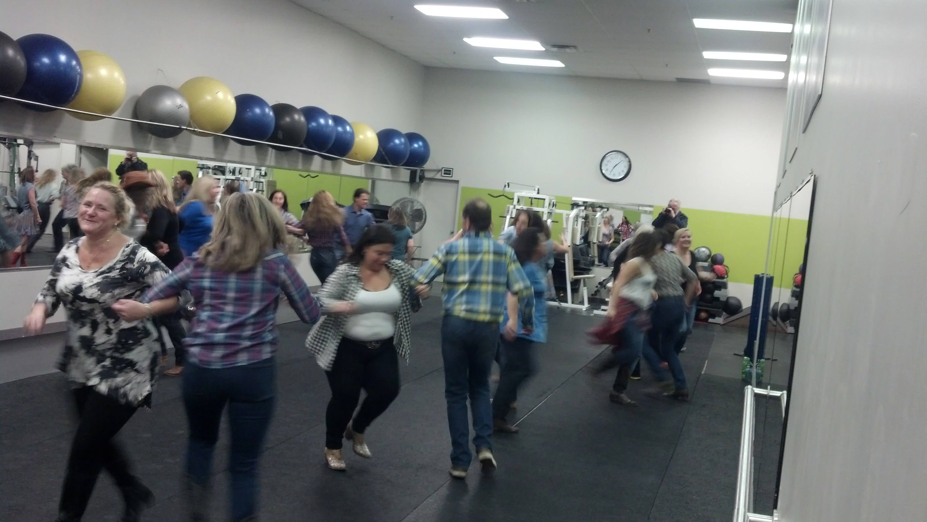
Line Dancing Partner Time

Slide 50
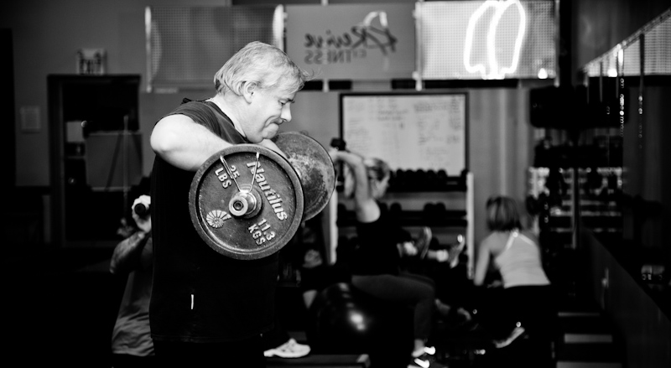
Weekend Warrior Class

Slide 51

Kickboxing

Slide 52

Circuit Training

Slide 53

Women Wine & Wellness

Slide 54

Grand Opening Nobleton

Slide 55

Grand Opening Ribbon Cutting

Slide 56

15 Year Revive Celebration

Slide 57

15 Year Celebration Workout

Slide 58

Good Times!

Slide 59

Fascia Stretch Therapy

Slide 60

FST

Slide 61

Caledon Women’s Hiking Group

Slide 62

Hiking Group Cross Training

Slide 63

WWW

Slide 64

Community Volleyball

Slide 65

Hardest Female Worker Award

Slide 66

Hardest Male Worker

Slide 67

Boxing

Slide 68

Yoga

Slide 69

Mobile Fitness

Slide 70

Virtual Training

Slide 71

Teen Hot Yoga

Slide 72

Ribfest Supporting Rotary Canada

Slide 73

FST Volunteering the Fair

Slide 74

Mobile Fitness Boot Camp

Slide 75

Fitness Seminar

Slide 76

Master Mind Fitness Group

Slide 77

Boxing Sponsorship

Slide 78

Revive Opens in Nobleton

Slide 79

Nobleton

Slide 80

Nobleton

Slide 81

10 Day Smoothie Reset Program

Slide 82

Girls Rock Fitness Summer Camp

Slide 83

Girls Rock Fitness

Slide 84

Stretch & Strength

Slide 85

Learn to Run Program

Slide 86

James Bolton
Community Fundraiser

Slide 87

Macville Fitness Fundraiser

Slide 88

Ellwood Public Fundraiser

Slide 89

Breakfast Television
Revive Girls Cheerleading

Slide 90

Stroller Fit

Slide 91

Career Day Presentation

Slide 92

Husband Wife Kickboxing

Slide 93

Halloween Party

Slide 94

Kids Christmas Bowling Party

Slide 95

Kids Outdoor Fitness
Circuit Training

Slide 96

Aquafitness

