Slide 1

WELLNESS

Slide 2
WELLMESS

Slide 3
Does anyone know the most popular day to start a program?

Slide 4
TOMORROW

Slide 5
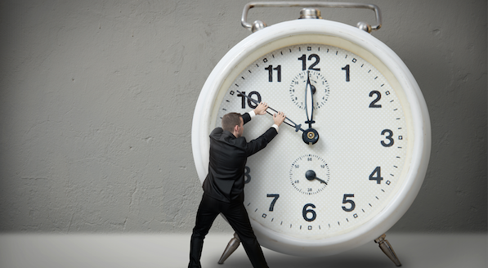

Slide 6

MIND. BODY. ENERGY.

Slide 7
WELLNESS is MINDFULNESS
Mastering how we think


Slide 8
Mindfulness is about putting down our juggling balls for a little bit.
It’s about embracing
the beauty of
mono-tasking.
TIME MAGAZINE JAN 2017

Slide 9
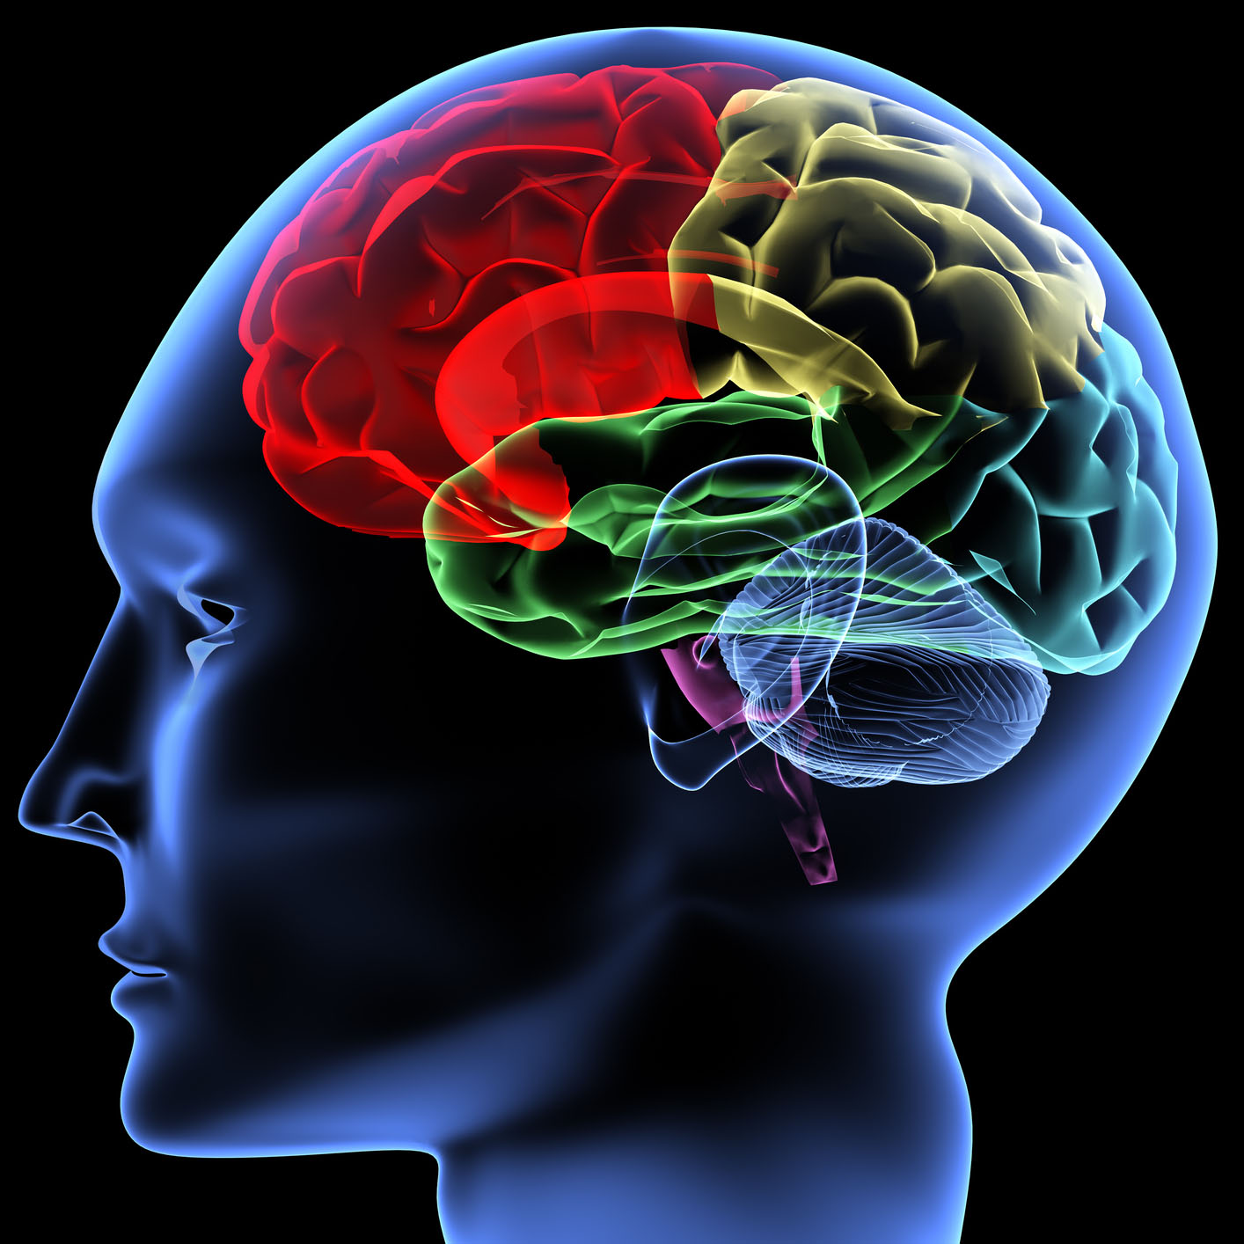
It’s all in YOUR MIND
You can’t change your mind overnight but you can change how you think.

Slide 10
Today’s Date:
DEC 28, 2017

Slide 11
DEC 28, 2016

Slide 12
Today’s Date:
DEC 28, 2017

Slide 13
1. Why will it be any different?

Slide 14
2. What are the things that stopped you?

Slide 15
3. Did you not know what to do or how to do it?

Slide 16
Set
Target
Business
Life?

Slide 17

Target

Slide 18
BELIEF

Slide 19
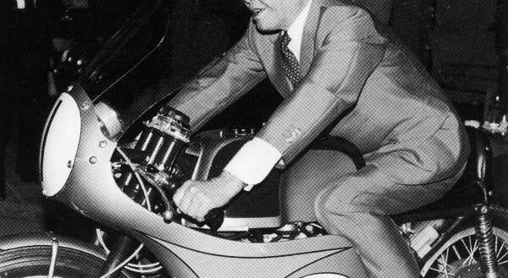
Soichiro Honda

Slide 20
7 MYTHS

Slide 21
SUCCESS MYTHS

Slide 22
Does anyone know
the most popular day
to start a program?

Slide 23
MONDAY.

Slide 24
1
Future Myth
Goals create success by telling us where to arrive tomorrow.
Truth
Goals create success by telling us what to do today.

Slide 25
2
Knowledge Myth
Success comes from knowing what to do.
Truth
Success comes from doing more of what we know.

Slide 26
3
Failure Myth
Failure is the opposite of success.
Truth
Failure is the path to achieve success.

Slide 27
4
Abundance Myth
Abundance is defined by what we have.
Truth
Abundance is defined by what we give.

Slide 28
5
Value Myth
Value is delivering more of what people want.
Truth
Value is created by delivering the unexpected.

Slide 29
6
Attraction Myth
We attract into our lives what we want to have.
Truth
We attract into our lives what we are being.

Slide 30
7
Happiness Myth
You can have happiness.
Truth
You can’t have happiness.
You can only be it.

Slide 31
Today’s Date:
DEC 28, 2017

Slide 32

VISUALIZATION

Slide 33
HAVE

Slide 34
DO

Slide 35
BE

Slide 36
HAVE
DO
BE

Slide 37
BE
DO
HAVE

Slide 38
BE IT
DO IT
HAVE IT

Slide 39
BE HAPPY
☺

